Slide 1

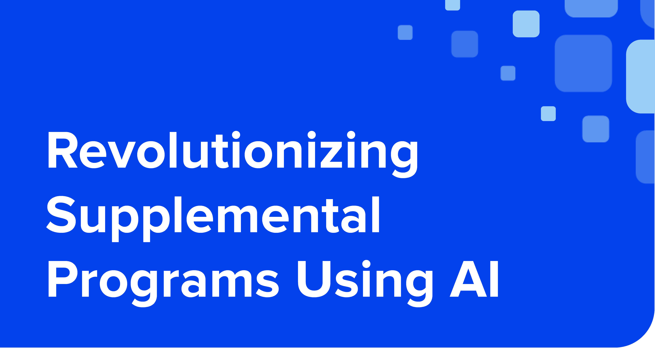
■
■
t:::JI Age of Learning
®

Slide 2
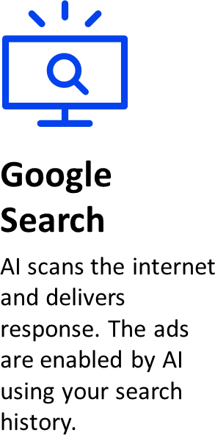

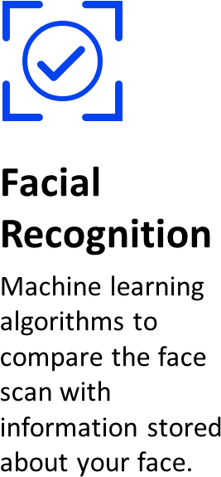
Social Media
Smart Home Devices
Digital voice assistants like Siri and Alexa.
Is my phone listening
to me!?
AI personalizes feeds based on past history, friend suggestions, identifying and filtering out fake news.
2

Slide 3
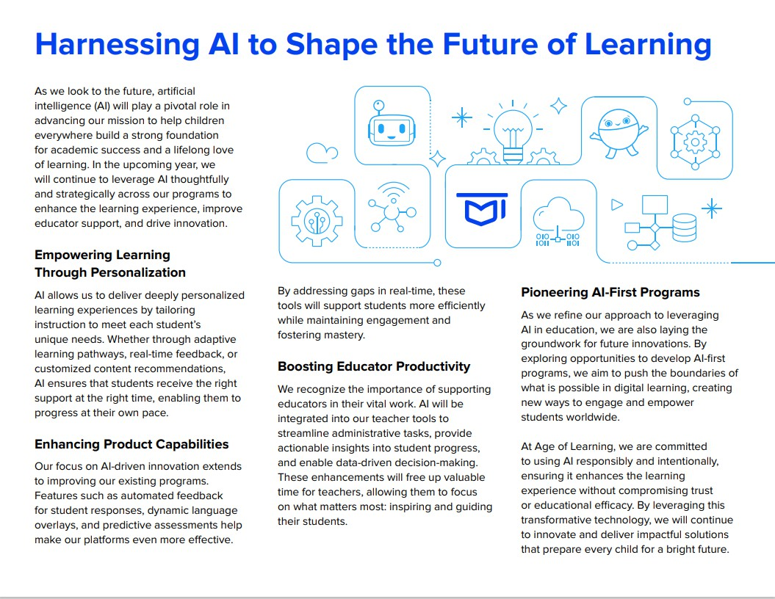


3

Slide 4
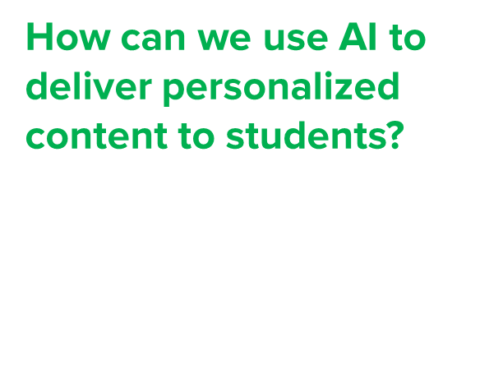
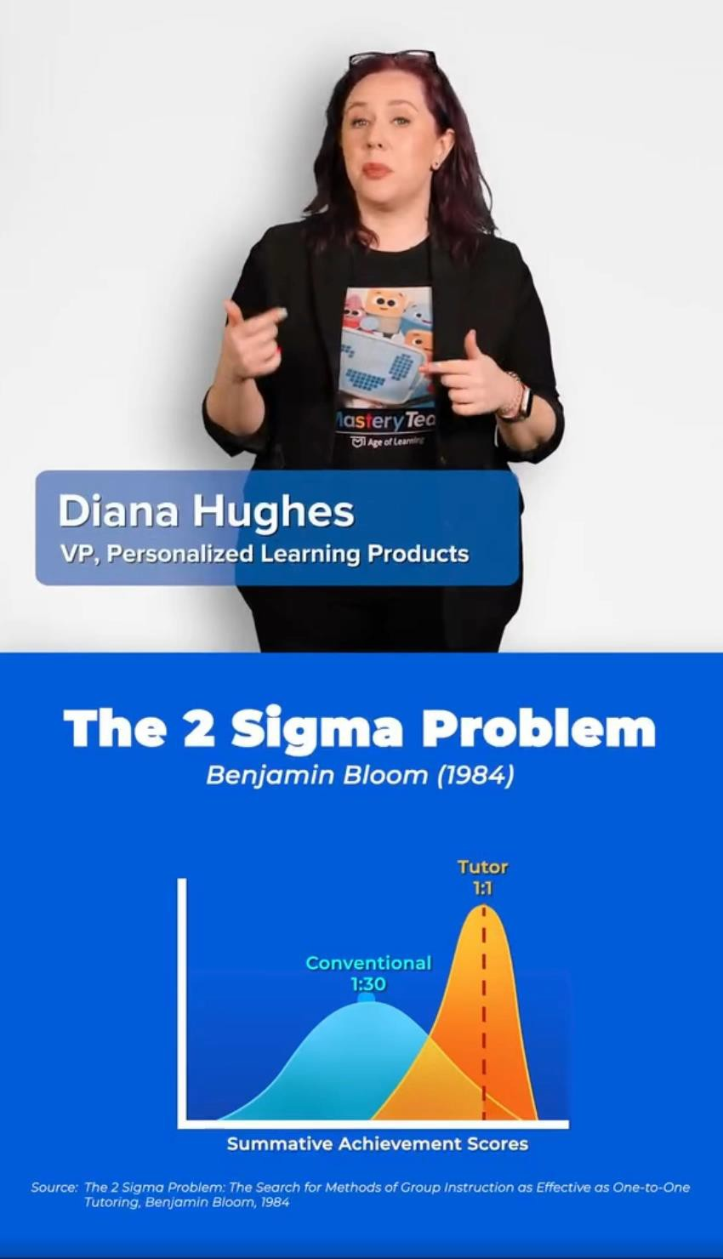





























Slide 5




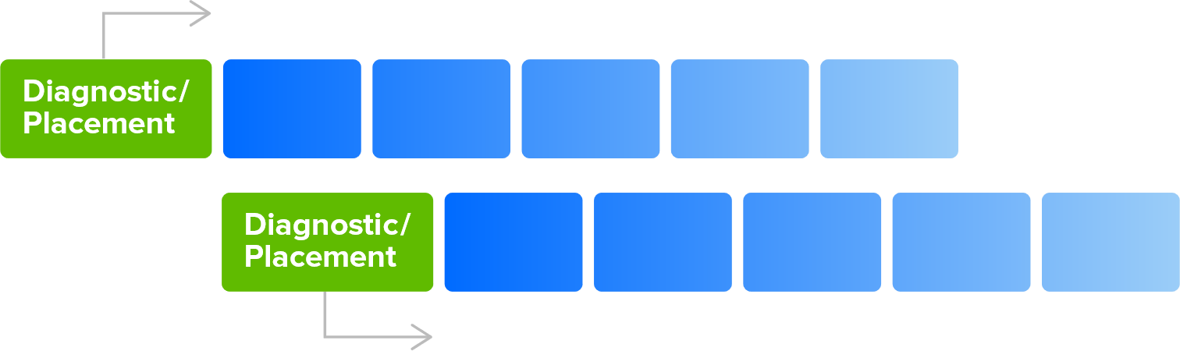


NOT LEVERAGING AI
Assigns
Pathway
Most accurate
Least accurate
Most accurate
Least accurate
Assigns
Pathway

Slide 6

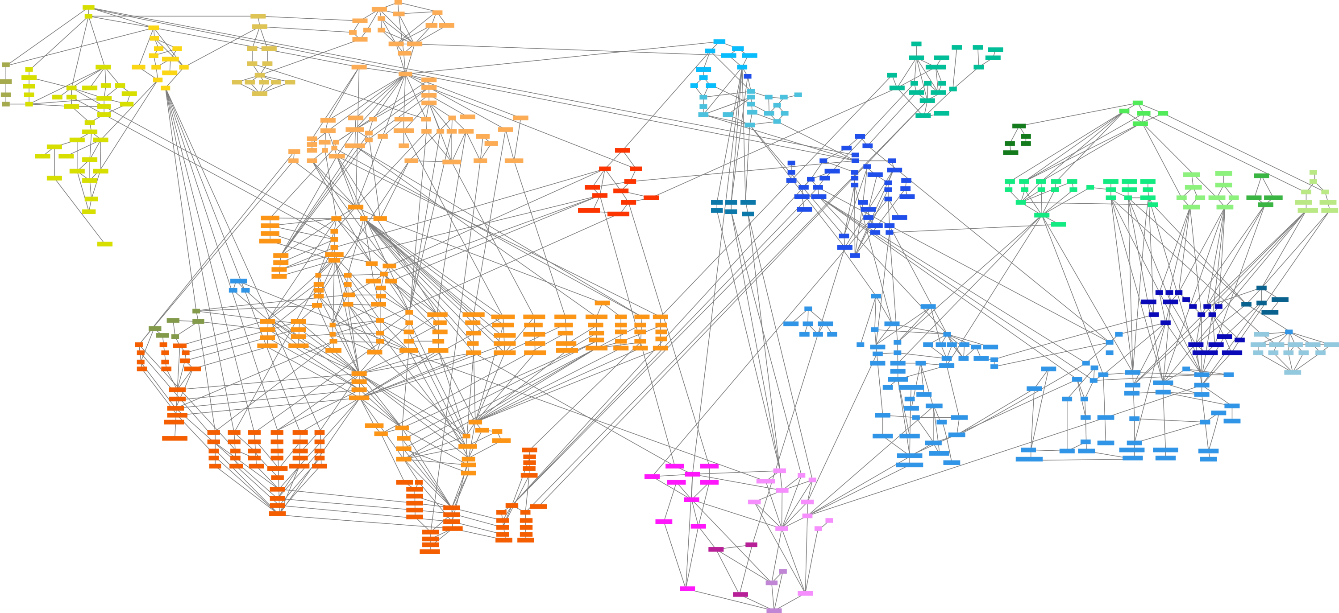














LEVERAGING AI
PROPRIETARY & CONFIDENTIAL ⁶

Slide 7


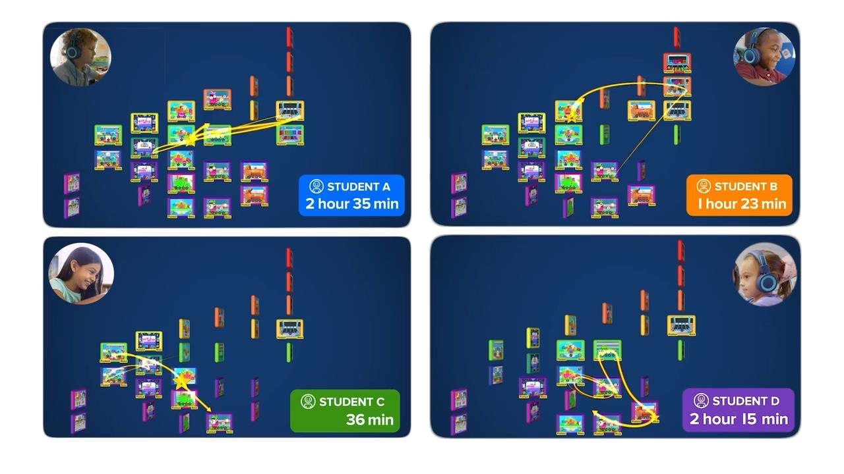

7

Slide 8


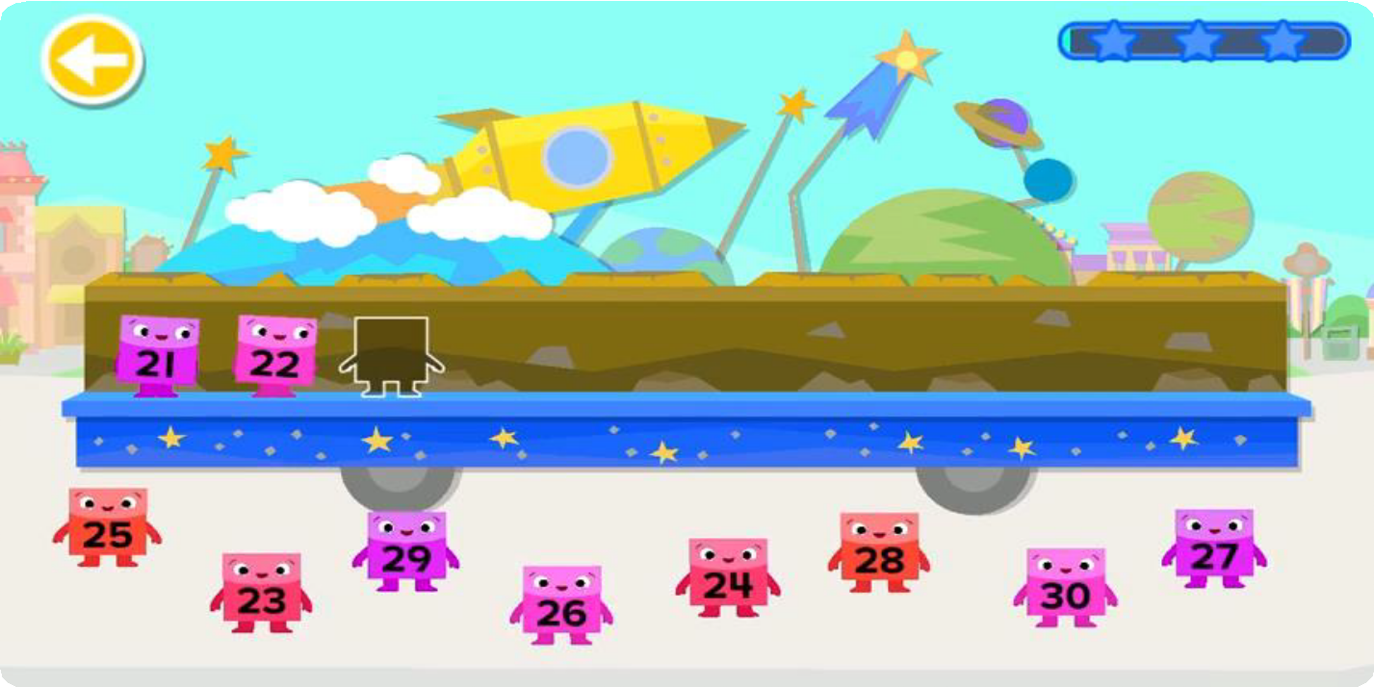


Slide 9

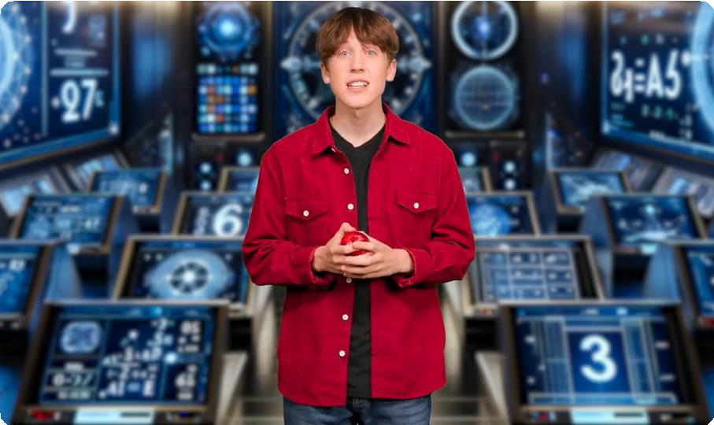

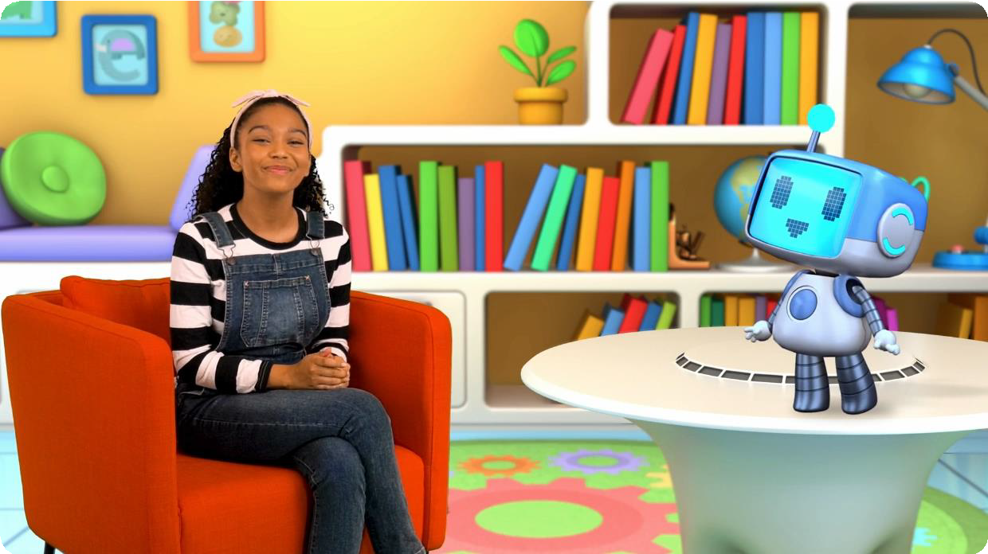
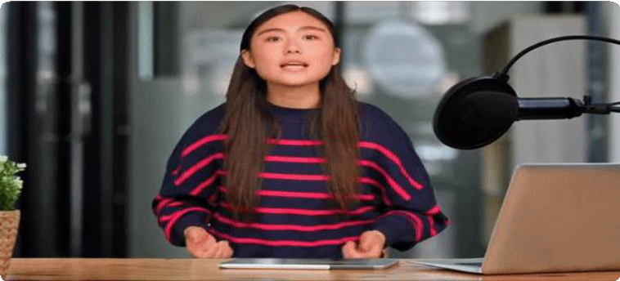

3 R D TO 5 T H
PRE - K TO 2 N D

Slide 10









60 34
34
hours per
subject
3x (~60m)
minutes per weeks
week / subject
74 hours

Slide 11



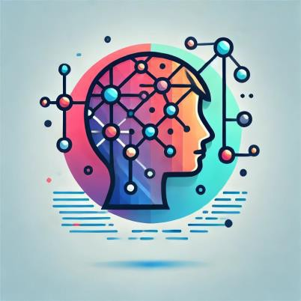
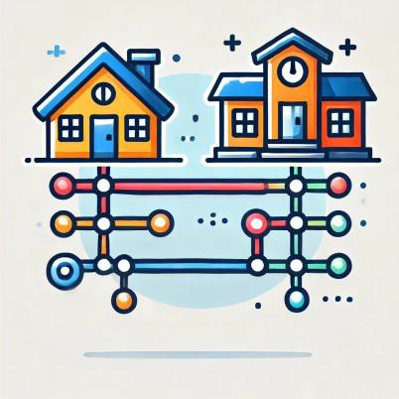
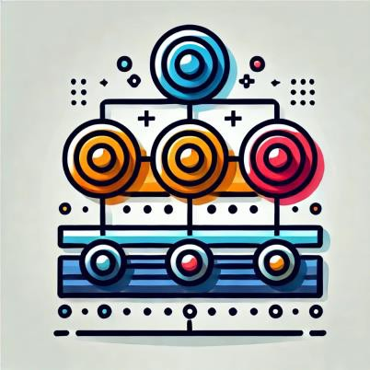

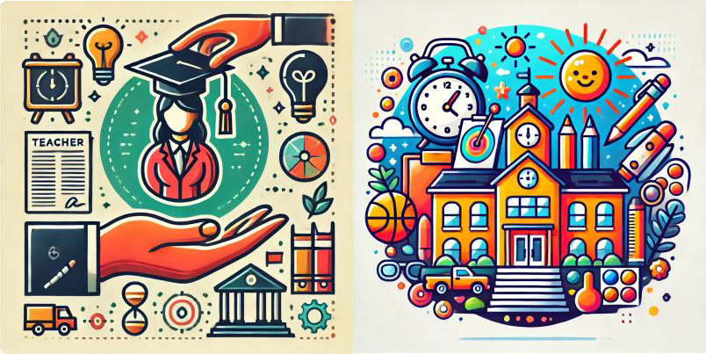
























Learning Centers
Kinder Readiness
Accelerated Learning
Gen A.I.
Unfinished Learning
Closing the Gap
Personalized Learning
School to Home
MTSS
MLL Learners
Teacher Support
After School Programs

Slide 12
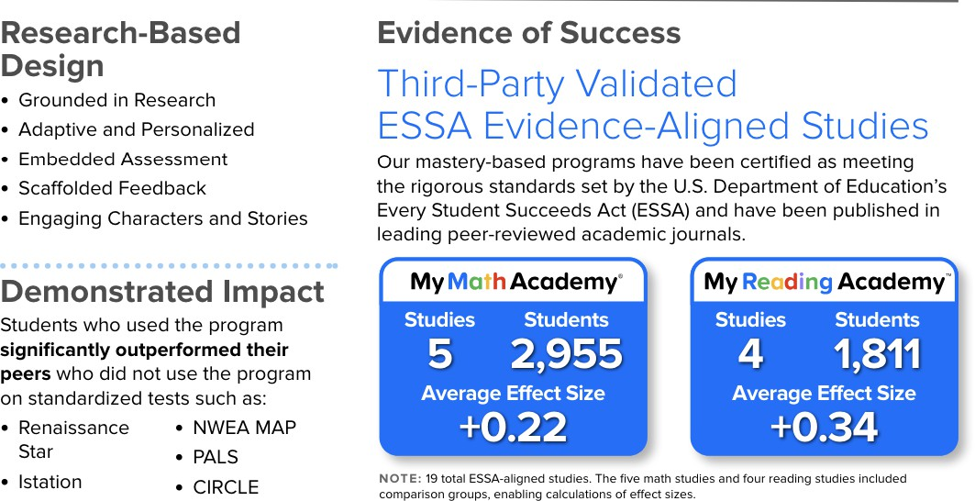
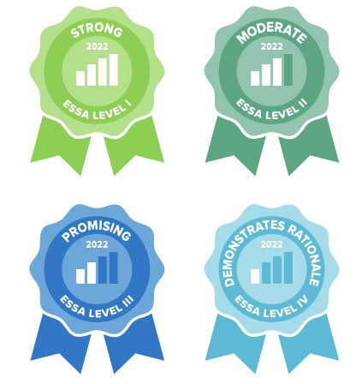

Slide 13

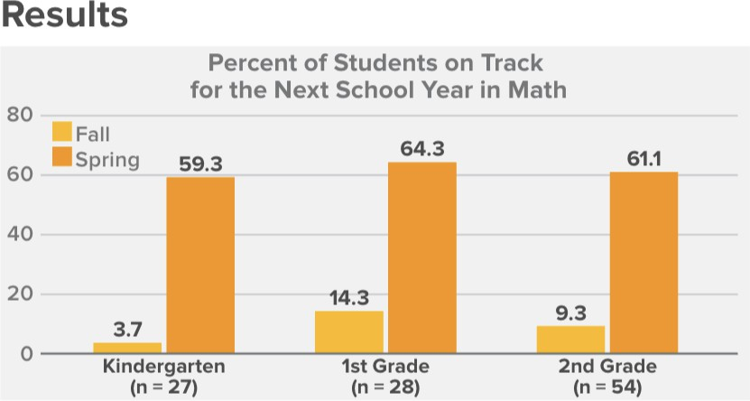

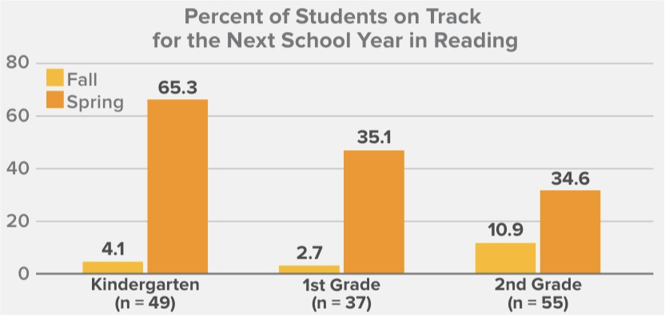

Slide 14
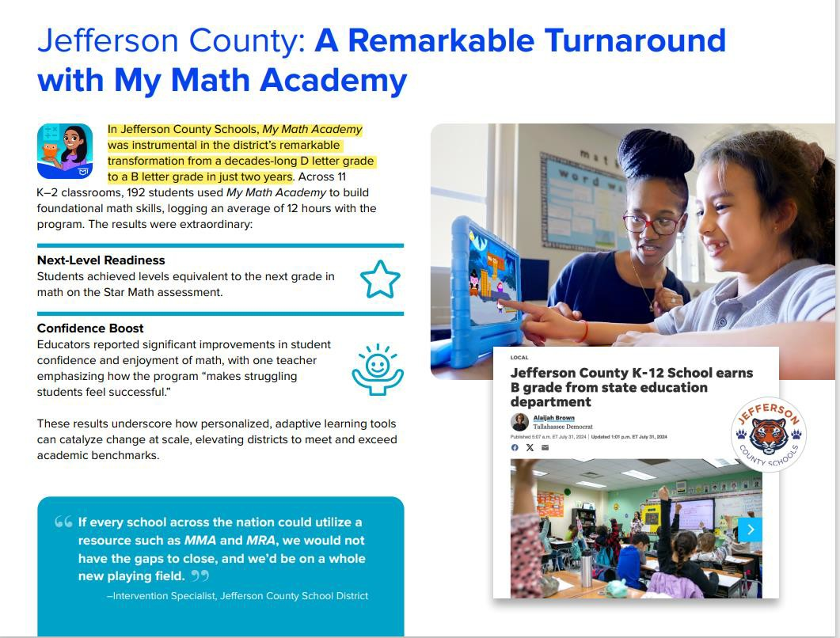
14

Slide 15
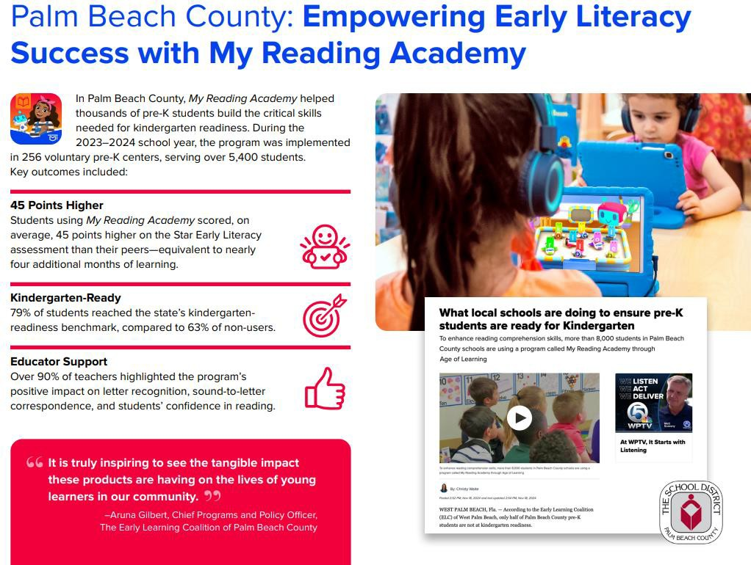
15

Slide 16




16

Slide 17
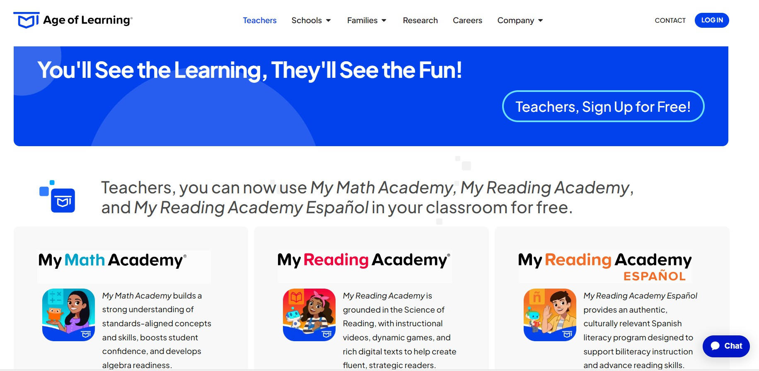

17
17

Slide 18









T H AN K Y O U
18

