Slide 1
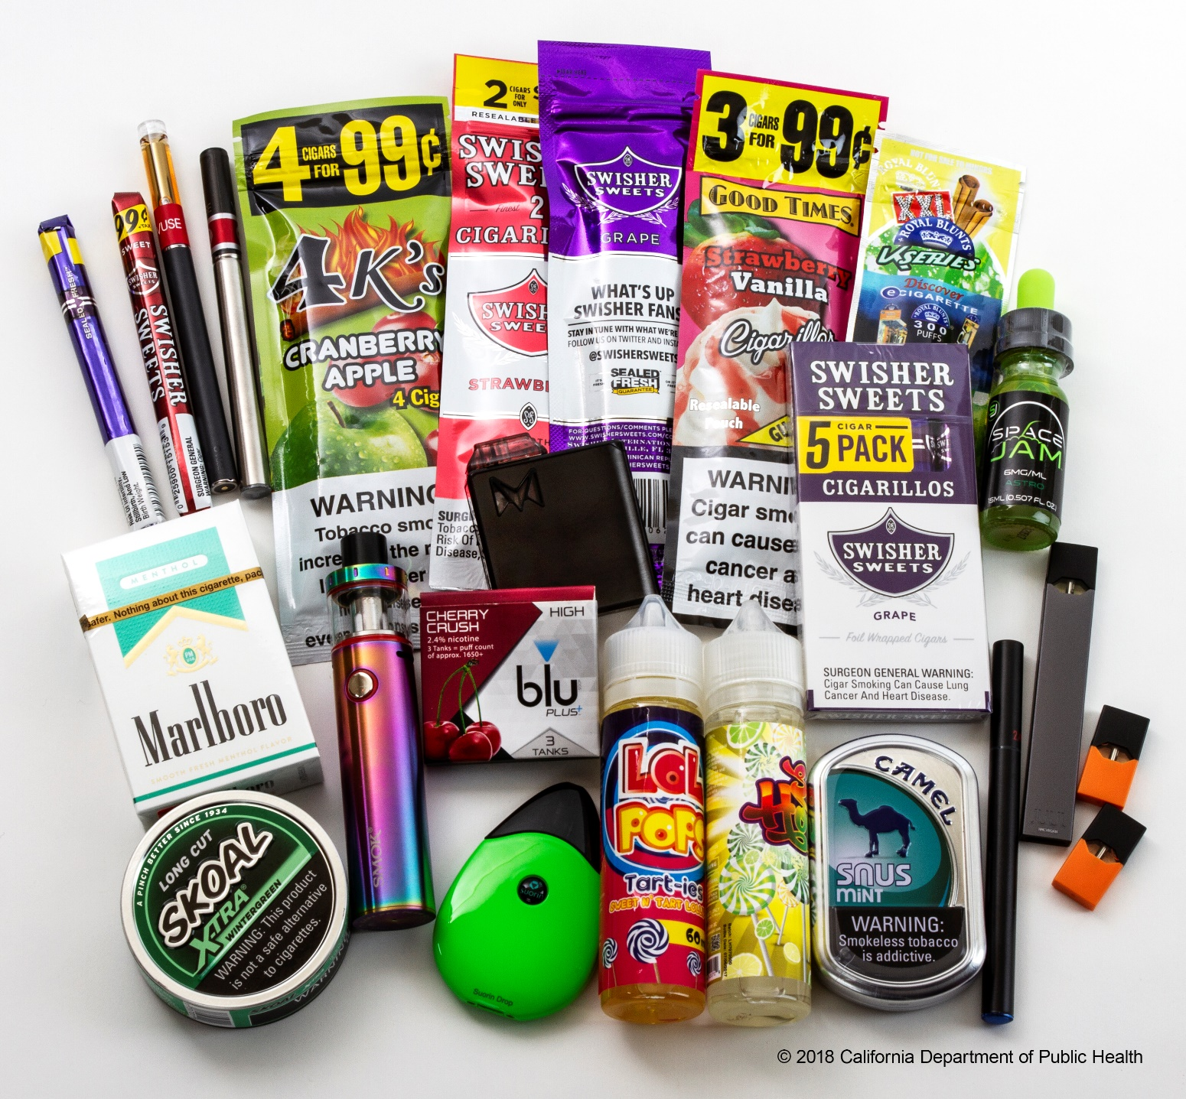
Flavored Tobacco Products Are Putting
a New Generation of Kids at Risk
Notes:
These flavors are clearly designed to appeal to kids.

Slide 2
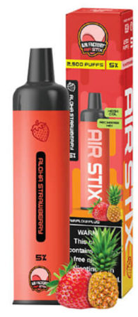
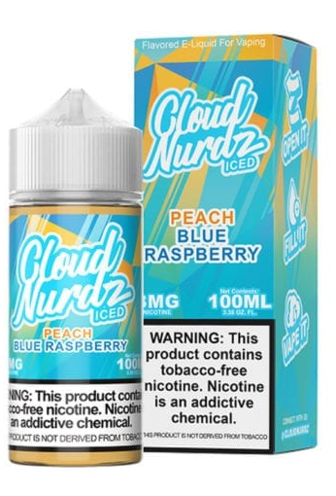
Youth Prefer Flavored E-Cigarettes
  87.6% of youth e-cigarette users use flavored products
  7 out of 10 of current youth e-cigarette users say they use e-cigarettes “because they come in flavors I like”
Source: 2024 NYTS & 2016-2017 PATH

Slide 3
Youth E-Cigarette Use Remains a Serious Public Health Concern
*
*2021 data is not comparable to other years due to a methodology change.
Source: CDC, National Youth Tobacco Survey (NYTS)
Notes:
The latest data from the National Youth Tobacco Survey show that 7.8% of high school students reported current e-cigarette use in 2024. While rates have declined since their peak in 2019, rates remain high the CDC and FDA continue to emphasize that youth e-cigarette use remains a serious public health concern, with over 1.6 million middle and high school students reporting current e-cigarette use in 2024.
(Note: 2021 data is not comparable to previous years due to a methodology change. Whereas previous surveys were conducted entirely in-school, the 2021 survey included both in-school and at-home responses; students who completed surveys in school reported higher e-cigarette use. Pandemic-related factors such as reduced access to e-cigarettes due to fewer peer interactions may have impacted youth e-cigarette use in 2021.)

Slide 4
Youth Addiction Crisis: Frequent E-Cigarette Use Among Youth Has More Than Doubled
*
*2021 NYTS data is not comparable to other years due to methodological differences.
Source: CDC, National Youth Tobacco Survey (NYTS), frequent use=20+days/month
Notes:
Data shows that kids are not just experimenting with these products. Rather, an increasing proportion of youth users are using them frequently or daily – an indicator of addiction. In 2024, 42.1% of high school e-cigarette users reported using e-cigarettes frequently (20 or more days per month), and 29.7% reported using e-cigarettes daily. From 2014 to 2024, frequent use increased from 15.5% to 42.1% and daily use increased from 9.7% to 29.7%

Slide 5
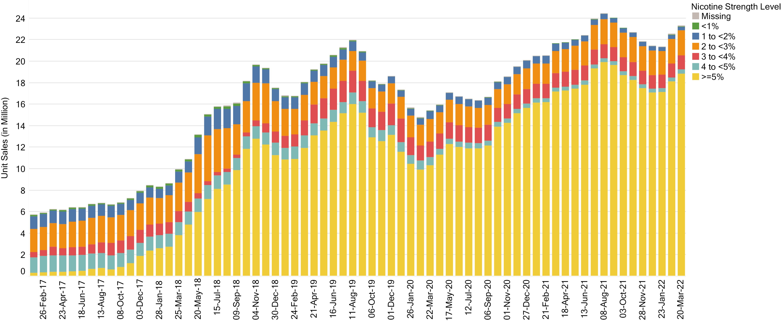
Nicotine Levels in E-Cigarettes Have Increased Dramatically
Source: Ali, FRM, et al. "Trends in US E-cigarette Sales and Prices by Nicotine Strength, Overall and by Product and Flavor Type, 2017–2022." Nicotine & Tobacco Research (2022).
Notes:
Today, high nicotine levels in e-cigarettes is very common.
JUUL introduced the use of nicotine salts to drive up the nicotine concentration of e-liquids, without the irritation that would normally accompany high nicotine exposure, thus making e-cigarettes with high nicotine e-liquids much easier to use by nicotine-naïve people, like youth.
The increased measures of addiction among youth, such as frequency of use (shown prior) is directly correlated with increases in the sale of high nicotine e-cigarettes
This slide shows trends in e-cigarette sales by nicotine strength from 2017 to 2022. The growing yellow bars reflect e-cigarettes with 5% nicotine content or greater. For reference, Juul claims that their 5% nicotine content product is equivalent to the amount of nicotine in a pack of 20 cigarettes. Products with 5% nicotine or higher increased from 5% to 81% of sales between January 2017 and March 2022. This shift you see was originally driven by Juul but many other products have emulated Juul and are available in even higher nicotine concentrations.
(Data not shown, but related if you want to mention): Large-format disposable e-cigarettes that allow for thousands of “puffs,” like Elf Bar, have also become widely available in recent years. One study aptly described current disposables on the market as “bigger, stronger and cheaper.” From January 2017 through September 2022, disposable e-cigarettes quintupled in e-liquid capacity and nearly tripled in average nicotine strength, while decreasing threefold in price per milliliter of e-liquid

Slide 6
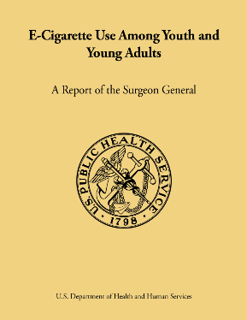
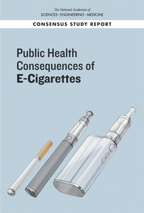
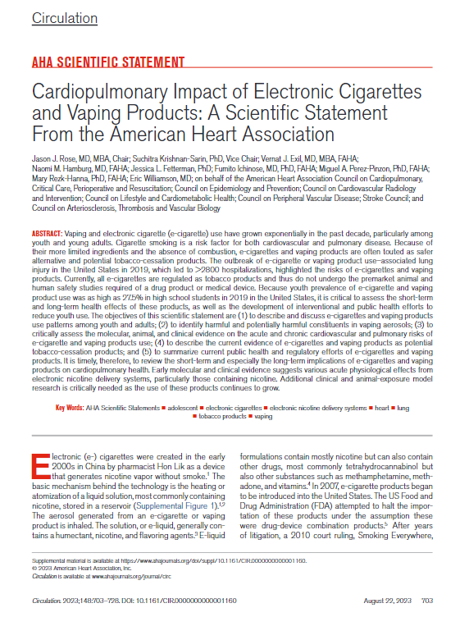
E-Cigarettes Are Not Harmless
E-cigarettes are not risk-free, but can be less harmful than combustible tobacco cigarettes if smokers switch completely.
Long-term effects are not yet clear.
Nicotine is a highly addictive drug that can have lasting damaging effects on adolescent brain development and impacts attention, memory and learning
Some evidence of harm to cardiovascular health.
Growing evidence that vaping can harm lung health, including compromising the ability to fight off infections.
Notes:
Available studies on short-term effects, such as changes in vascular stiffness, blood pressure, and heart rate, suggest that vaping during adolescence may lead to increased likelihood of cardiovascular disease later in life

Slide 7
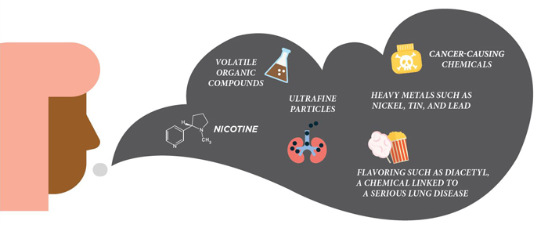
What is in E-Cigarette Aerosol?
https://www.cdc.gov/tobacco/basic_information/e-cigarettes/Quick-Facts-on-the-Risks-of-E-cigarettes-for-Kids-Teens-and-Young-Adults.html

Slide 8
Kids are exposed to e-cigarette marketing
17.8 million kids saw e-cigarette advertising
70.3% of middle school and high school students were exposed to e-cigarette marketing
58.7% of middle school and high school students saw e-cigarette ads or promotions in retail stores.
Among youth reporting social media use, 73.5% saw e-cigarette posts or content.
Source: CDC, 2021 National Youth Tobacco Survey (NYTS)
Notes:
The U.S. Federal Trade Commission only recently began to collect data on marketing and promotional spending by the top e-cigarette companies (6 companies during 2015-2018: Fontem US, Inc. (blu e-cigs); JUUL Labs, Inc.; Logic Technology Development LLC; NJOY, LLC; Altria/Nu Mark LLC; and R.J. Reynolds Vapor Company. 5 companies during 2019-2020: Fontem US, Inc.; JUUL Labs, Inc.; Logic Technology Development LLC; NJOY, LLC; and R.J. Reynolds Vapor Company).
Marketing spending peaked at $1 billion in 2019, coinciding with the peak in youth e-cig use. Most recent data are from 2020, showing $719.9 million spent on marketing and advertising in total.
While spending has declined, social media marketing, which is generally cheaper than other forms of marketing, has been a big part of e-cig marketing.

Slide 9
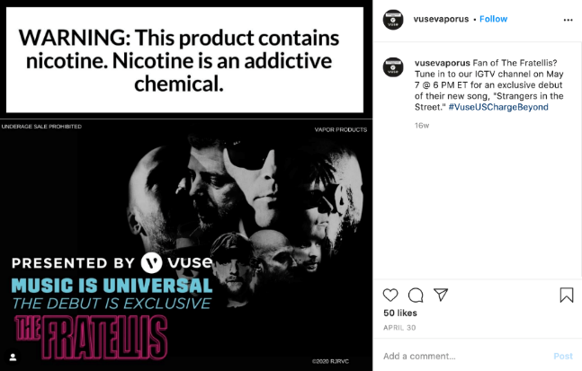

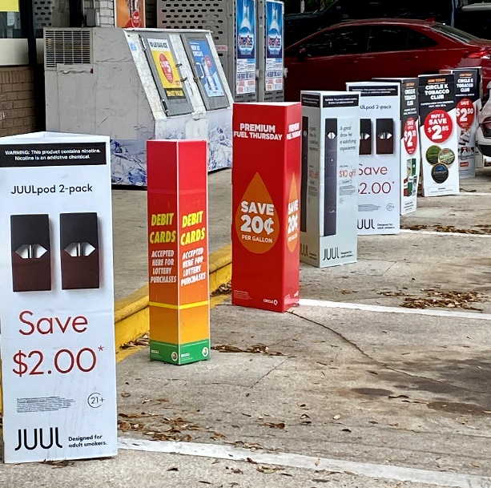
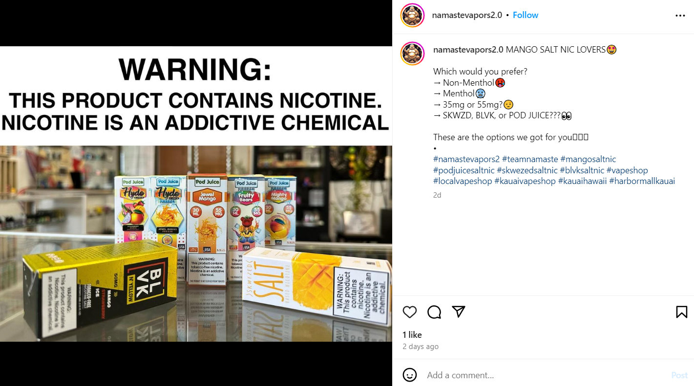
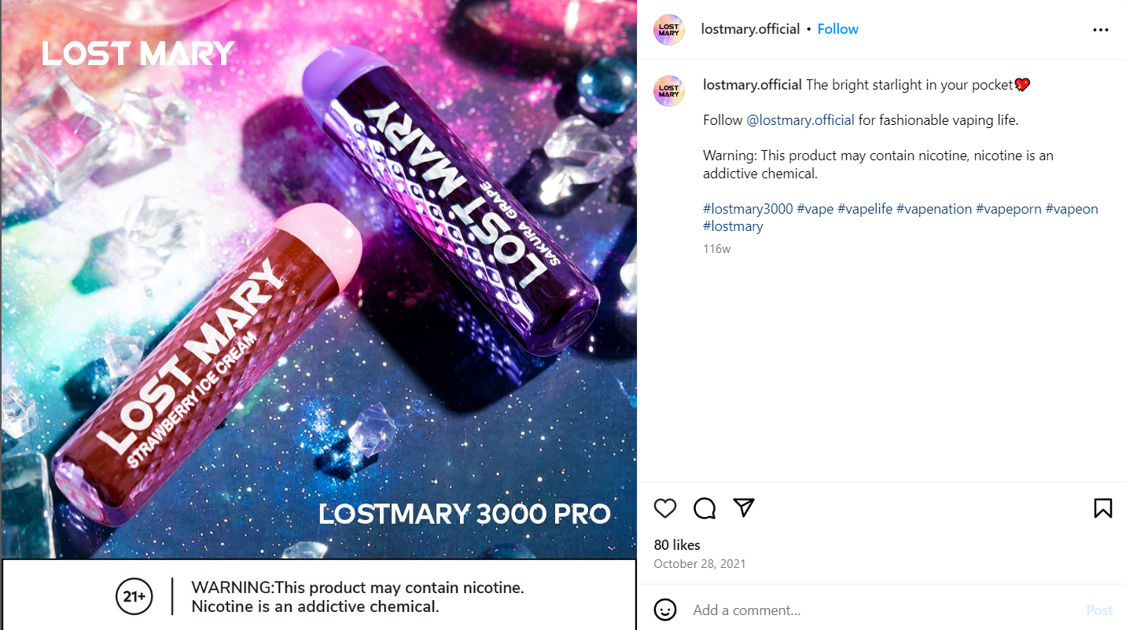
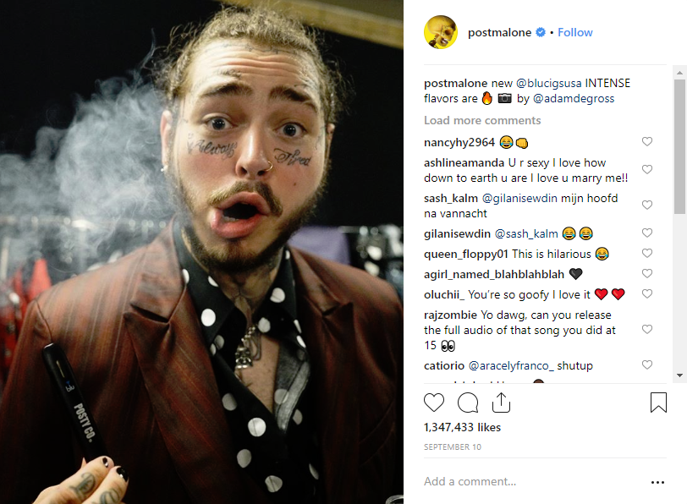
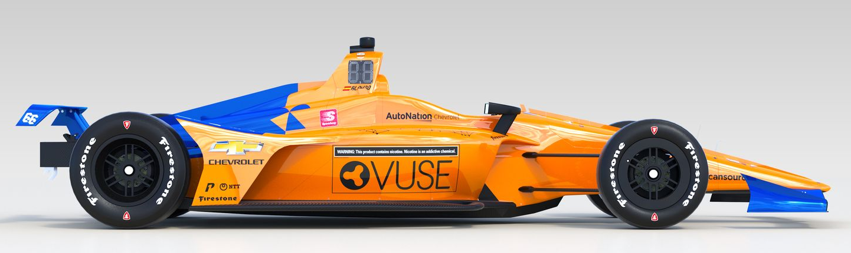
Examples of E-Cigarette Marketing
Influencers
Sponsored
Concerts
Point-of-Sale Ads
Vape Shop Marketing
Social Media Marketing
Celebrity Endorsements
Sports Sponsorships

Slide 10

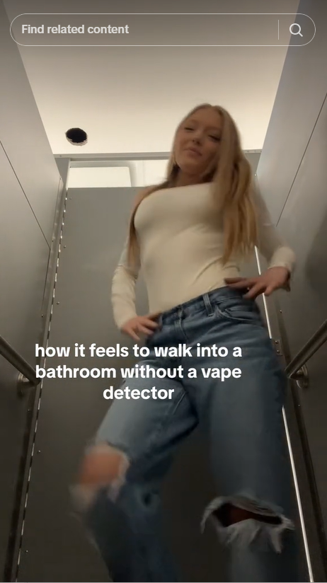
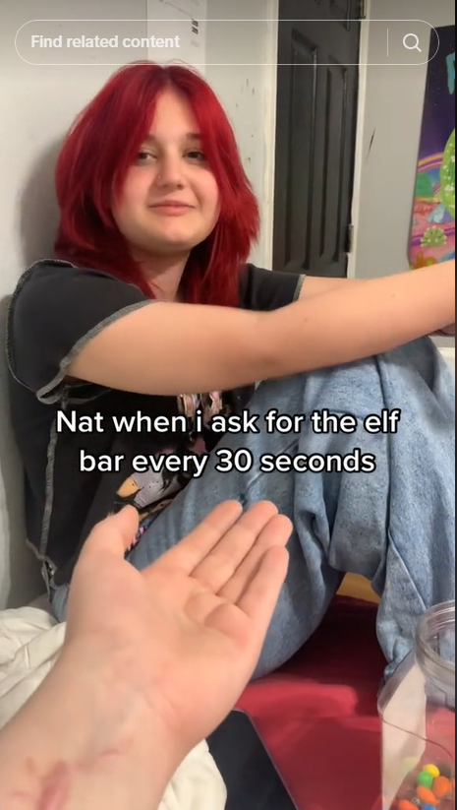
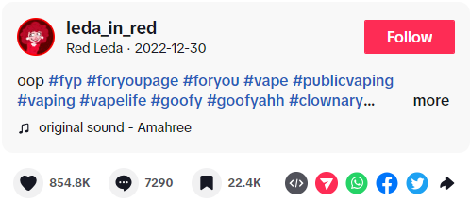
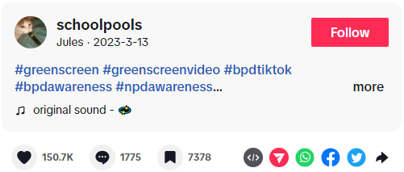
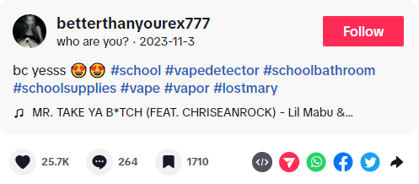
Examples of Peer-to-Peer Marketing
Dec 30, 2022, https://www.tiktok.com/@leda_in_red/video/7183094339592047914
https://www.tiktok.com/@betterthanyourex777/video/7297258909734210862
March 13, 2023, https://www.tiktok.com/@schoolpools/video/7209910006005697835

Slide 11
Flavored E-Cigarettes Are Driving Youth Use
*
*2021 data is not comparable to other years due to a methodology change.
Source: CDC, National Youth Tobacco Survey (NYTS)
Notes:
Youth e-cigarette use continues to be driven by the widespread availability of flavored products – in 2024, 87.6% of youth e-cigarette users reported using flavored e-cigarettes. Among youth users of flavored e-cigarettes, the most commonly used flavor types are fruit and candy flavors, followed by mint and menthol.

Slide 12
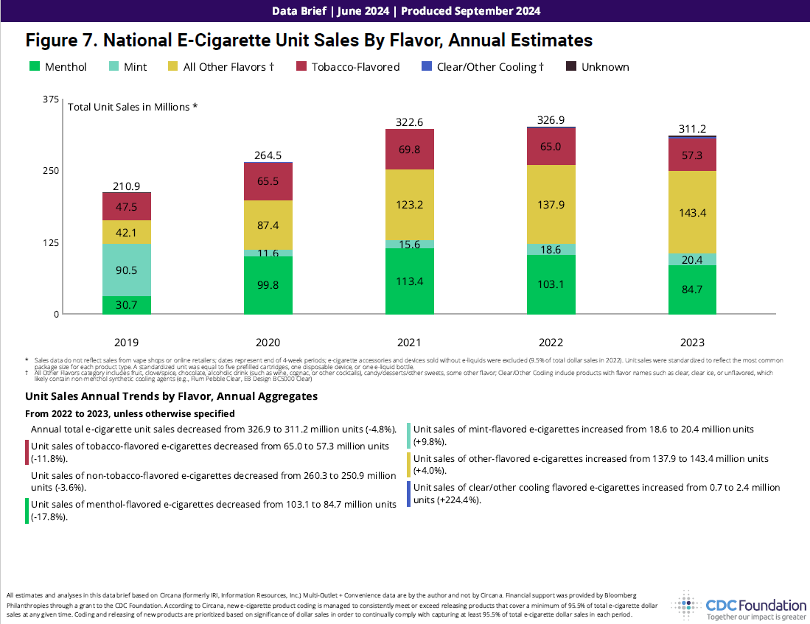
Notes:
The February 2020 policy led to increases in the sale and market share of menthol-flavored e-cigarettes (the dark green color), which were exempt from the flavor restrictions on cartridge-based products like Juul. From 2019 to 2020, the market share of menthol-flavored e-cigarettes more than doubled. The latest data show that as of June 16, 2024, menthol-flavored e-cigarette sales accounted for 27.2% of the overall e-cigarette market and 60.6% of the prefilled cartridge market. Menthol e-cigarettes remain popular among youth. In 2024, 17% of high school e-cigarette users reported using menthol-flavored products

Slide 13
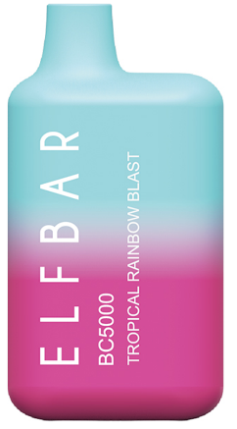
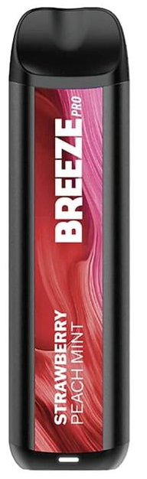
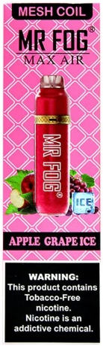
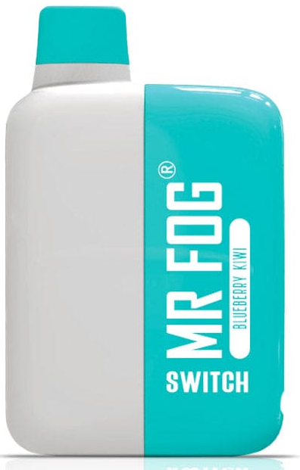
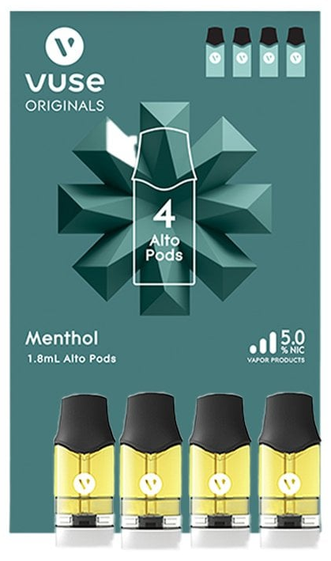
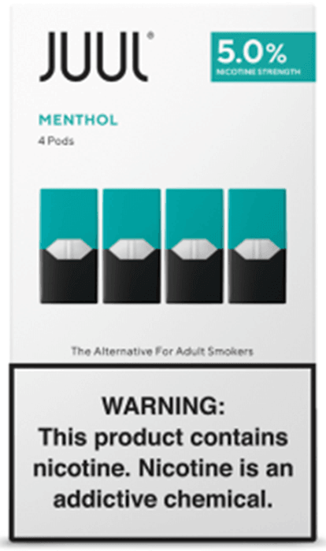
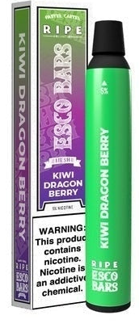
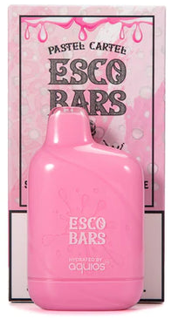
Most Popular E-Cigarette Brands Among High School Users, 2024
Elf Bar (36.1%)
2. Breeze (19.9%)
3. Mr. Fog (15.8%)
4. Vuse (13.7%)
5. JUUL (12.6%)
6. Esco Bars (10.2%)
Source: CDC, National Youth Tobacco Survey (NYTS), data represents any use of a brand in the last 30 days
Notes:
The most popular products among youth have changed greatly year to year, reflecting changes in FDA regulation and enforcement priorities.
Of the top selling brands among youth in 2024, Elf Bar, Esco Bar, Mr. Fog and Breeze are disposable e-cigarettes whereas Juul and Vuse are prefilled cartridges.
These popular youth brands are also among the top-selling brands nationally. The top ten brands during the period spanning April 21, 2024 through June 16, 2024, were (in descending order of dollar sales) Vuse, JUUL, Geek Bar Pulse, Breeze Smoke, NJOY, RAZ, HQD, Loon Maxx, Breeze Prime, and Juicy Bar
Elf Bar, Esco Bars, Mr. Fog and Breeze are all on the market illegally and despite being subject to many FDA enforcement actions, continue to be widely available. While the FDA denied marketing applications for all Juul products in June 2022, it subsequently rescinded their denial and Juul’s applications remain under review. The FDA also denied marketing applications for the popular Vuse Alto product, but this order is currently being litigated.

Slide 14
Status of FDA E-Cigarette Enforcement
Since 2020, FDA has received applications for 27 million tobacco products, the vast majority of which are e-cigarettes. As of September 2024, 500,000 applications are still pending review
FDA has only authorized 34 tobacco- and menthol- flavored e-cigarette products and devices, yet over 6,000 e-cigarette products are on the market illegally
Despite FDA action, e-cigarette sales continued to grow after 2020, fueled by illegal flavored e-cigarettes, especially disposable e-cigarettes

Slide 15
Sales Restrictions on Flavored Tobacco Products
CO=7
MN=30
ME=8
*
Prohibits the sale of all flavored tobacco products
Prohibits the sale of flavored e-cigarettes
Local restriction on the sale of flavored tobacco products
>380 localities have enacted restrictions on the sale of flavored tobacco products.
In addition to the states above, Rhode Island prohibits the sale of flavored e-cigarettes, except menthol e-cigarettes. MD and UT restrict the sale of some types of flavored e-cigarettes (UT only in certain locations)
*CA exempts flavored premium cigars and roll-your-own tobacco, as well as on-site consumption of flavored hookah tobacco
August 2024
Notes:
4 states – California, Massachusetts, New Jersey, and New York prohibit the sale of all flavored e-cigarettes. California and Massachusetts also prohibit the sale of other tobacco products, including menthol cigarettes.
Rhode Island prohibits the sale of all flavored e-cigarettes, except menthol-flavored products.
Maryland’s state comptroller prioritizes enforcement against flavored, cartridge-based and disposable e-cigarettes (except for tobacco or menthol)
Utah restricts sale of flavored-e-cigarettes (except for menthol and mint) to adult-only
retail tobacco specialty businesses.
Over 380 localities have enacted restrictions the sale of flavored tobacco products

Slide 16
Impact of State and Local Restrictions on Flavored E-Cigarettes
States can act more quickly than the FDA to clear the market of flavored e-cigarettes
Youth and young adults who live in an area covered by a flavor tobacco restriction have lower odds of any tobacco use and current flavored tobacco use compared to those who lived in an area with no flavor restriction
Flavored e-cigarette sales have declined by over 90% in Massachusetts and Rhode Island and by over 70% in New York California since implementation of their laws prohibiting the sale of all flavored e-cigarettes
Despite claims that e-cigarette flavor restrictions could lead to increases in smoking, states that have prohibited flavored e-cigarettes also experience declines in cigarette sales
Preliminary data from Massachusetts shows declines in youth e-cigarette use

