Slide 1
Distance Learning and Online Coordination of Services in PA Rural Schools during COVID-19
Gerry Letendre, Ph.D.
Peggy Schooling, Ed.D.

Slide 2
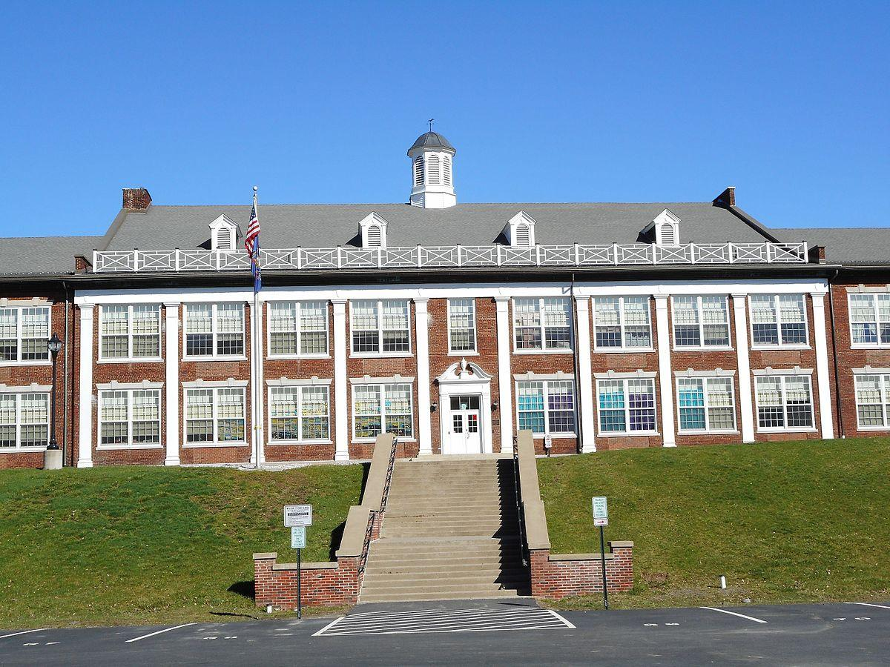
The Context
Schools are at the center of communication in rural communities.
Rural schools have long faced insufficient funding and other barriers to online education.

Slide 3
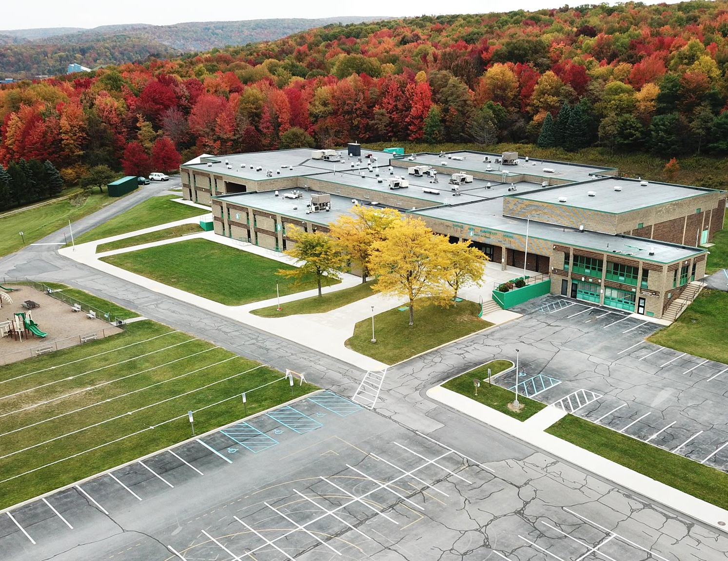
The Problem
The COVID 19 pandemic disrupted community/school relations and exposed vulnerabilities in the ability of rural schools to provide:
  Distance education
  Essential non-educational services

Slide 4
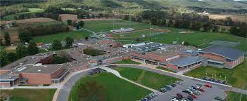
Demographics
In 2018, 26% of the state’s residents, lived in Pennsylvania’s 48 rural counties. (U.S. Census Bureau)
There are 235/500 rural school districts in PA
Enrollments range from 200 to nearly 10,000 students

Slide 5
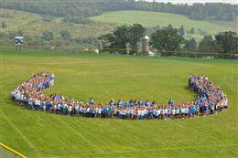
Purpose of Our Study
Understand the specific problems that rural school districts encountered during the pandemic.
Learn how these districts responded to their unique challenges.
Identify the policies, practices, and resources that are needed for PA rural schools in the event of future emergencies.
Notes:
To understand the challenges rural school districts encountered during the pandemic related to distance learning and the online coordination of non-educational services, and the solutions districts used to meet those challenges.
To determine how rural school districts have made use of distance learning models and online coordination of non-educational services in their long-term planning for school closure.
To learn what policies, practices, or resources local stakeholders in rural school districts believe are necessary to ensure equitable access to a high-quality educational experience during times of extended school closure for rural students and their families.
To inform policymakers of the condition of rural schools regarding their ability to provide distance learning, their planning and preparedness for sudden school closures, and the recommendations of rural district stakeholders to help their districts and communities.

Slide 6

Data Collection Tasks
Website Analysis
Central Planning Documents Analysis
Identification of Specific Barriers or Challenges and Specific Practices or Resources (Survey and Focus Groups)
Identification of Helpful Policies (Delphi Study)
Notes:
Website analysis: All 235 rural school district websites were reviewed & analyzed. vast majority of rural school districts did use their websites to keep their communities informed about COVID-related developments. However, there were great differences in the placement/location of important announcements, in the levels of detail and topics covered, as well as the timeliness of updates.
Central planning document analysis: gathered rural school district central planning documents — Continuity of Education Plans, Health and Safety Plans, and Flexible Instructional Day plans. Our statistical analysis of these documents reveal low coverage rates of important topics (such as online learning platforms, internet access, and mental health) which is indicative of widespread lack of preparedness
Survey distributed to all rural superintendents. asked both closed and open-ended questions on critical issues, problems, resources, and asked to provide their recommendations. response rate of 49.4%, resulting in 116 completed surveys.
Focus group interviews: Two separate focus group interviews with a total of 6 rural district superintendents, 3 Intermediate Unit executive directors, and 1 director of curriculum were conducted. There were 5 questions posed. The questions were informed by answers received from the survey we had completed. Each focus group lasted approximately 90 minutes, providing highly in-depth responses.
•Delphi study: The data gathered from the survey and focus groups were utilized to create our three-wave Delphi study, which is a useful and proven method to identify policy recommendations that have high levels of support across a range of stakeholders. We conducted the study with 28 individuals (who were a representative sample of parents, teachers, school board members and administrators) who completed the first two roundshe survey and showed high levels of agreement about the policy recommendations needed to improve the readiness of their rural schools for emergencies and extended school closures

Slide 7
Focus Groups and Delphi Study
Two focus groups with rural superintendents, IU Directors and other leaders
A Delphi study of 28 rural school administrators, school board members, parents and teachers

Slide 8
Focus Group -“No one thought initially about long term closures.”
“It was really a tremendous feeling of uncertainty, because there was no timetable at that point given, and we weren’t sure if schools would be closed for a week or for two weeks. No one thought initially about long term closures.”
On March 13, 2020 Governor Wolf ordered that all K–12 Pennsylvania schools would close due to the COVID pandemic. Our respondents anticipated receiving information from the Secretary of Education earlier that morning during a statewide meeting, but there was no mention of school closings during that meeting. This left rural districts “on their own” to map out strategies and mobilize resources

Slide 9
Focus Group - “School districts became the hub of the community.”
Suddenly, school districts became the center for community information about the pandemic, but also provision of multiple social services. One superintendent noted: “I was personally responding to 100 emails a day from parents concerned about losing their jobs, feeding their children, finding day care.”
“I think it showed the community, the power of the educational industry, the fact that, I think, we were the one stable thing that everybody could turn to in keeping families together, in keeping children fed.”

Slide 10
Focus Group - Long-term Planning – Curriculum and PD
At the most basic level, districts established processes for distributing student learning packets via school pickup and distribution of materials at bus stops. Other districts centered their efforts on expanding access to Learning Management Systems (LMS) such as Google Classrooms, taking inventory of the personal technology devices available within the school and in the homes, establishing processes for delivering devices to children and their families, and retooling teachers with professional development. This showed the wide range of differences in rural district needs

Slide 11
Focus Group - Specific Recommendations
A commitment from state legislators and policymakers to ensure that families in rural school districts have access to affordable, high-speed broadband internet;
Changes to the Pennsylvania School Code provisions regarding instructional time and hours to better align with effective practices in distance learning, i.e, replace the 180-day requirement with competency-based standards;
Allow more FID days, recognizing that school districts are now able to move from face-to-face to online learning formats more flexibly than ever before;
Statewide professional development on course design and teaching strategies for an online environment.

Slide 12
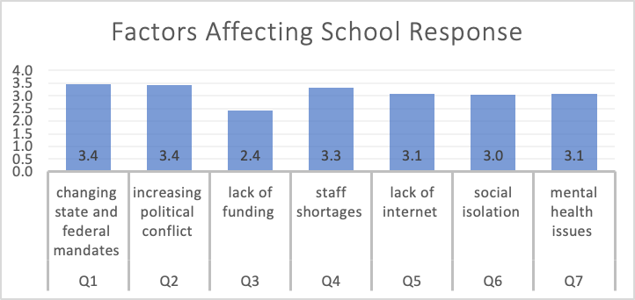
Delphi Study - Factors that Affected School Response Capacity
1 = No Effect
2 = Some Effect
3 = Moderate Effect
4 = Major Effect

Slide 13
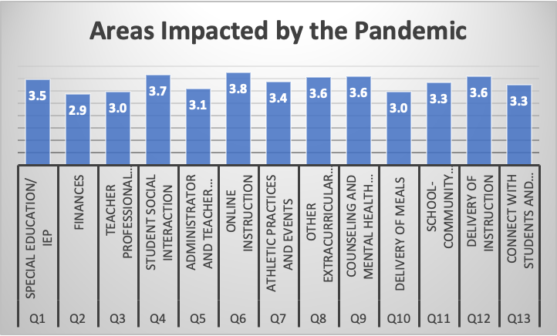
Delphi Study - Areas of School Impacted by the Pandemic
1 = No Impact
2 = Minor Impact
3 = Moderate Impact
4 = Major Impact

Slide 14
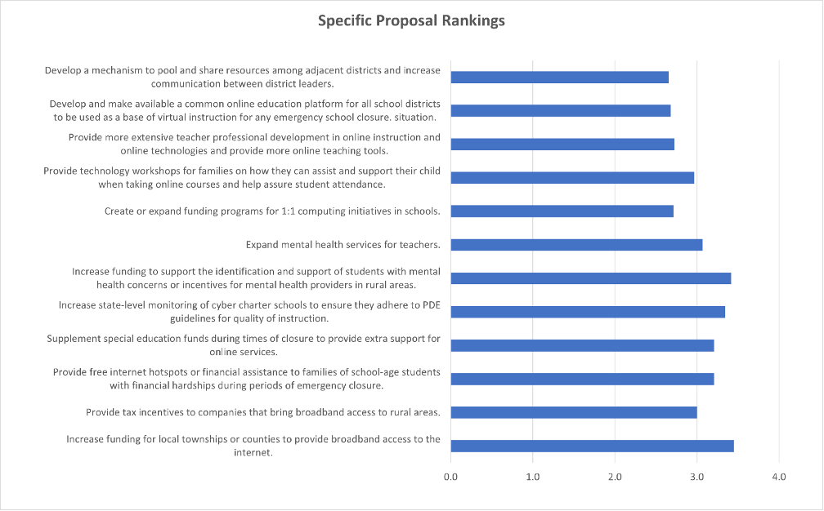
Delphi Study - Ranking of Policy Proposals
1 = Not a Priority
2 = Low Priority
3 = Moderate Priority
4 = Highest Priority

Slide 15
Conclusion
Focus groups revealed each district struggled with unique challenges that reflected the incredible diversity of rural district conditions.
Administrators agreed that support for broadband access, modifications to the school code and increased PD were essential.
Delphi study showed strong support across stakeholders for key legislative reforms to support rural school districts.

