Slide 1
Michael Maley
D.H.H. Lengel Middle School Principal - Pottsville Area
East II -Secondary Representative - PA Principals Association

Slide 2
Moving to Planned Instruction
“As educators preparing students to continue on to postsecondary opportunities, the workforce or transitioning to their next grade, it is our responsibility and expectation that every school offer planned instruction at every grade level for all students. “ (https://www.education.pa.gov/Schools/safeschools/emergencyplanning/COVID-19/messages/Pages/April15.aspx)

Slide 3
Immediate Con
Parents perception of online learning!

Slide 4
170
DAYS

Slide 5
How does this impact Pottsville Area?
3 questions we asked ourselves:
What do we want our students to learn?
How are teachers going to deliver instruction?
How do we assess learning?

Slide 6
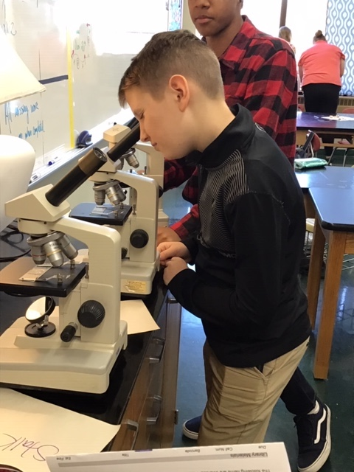
Desired Results
Backward Approach
What knowledge did we we want our students to leave with?
What skills are essential to learning and promotion?
6 week time frame
4/20-5/29
Last Official Day 6/1/20

Slide 7
Delivery of Instruction
Asynchronous
Provides families flexibility
Allows for continuous review
Google Classroom and Email
Students proficiency
Ability to communicate and share
Office Hours
Designate three (3) 2-hour blocks during the week for students
Parent communication - via email

Slide 8
Assess Learning
Weekly work submissions and teacher communication
Documents participation and attendance
3MP - allow for any missing work to be complete and submitted - No grade lower than a 60%
4MP - Pass or Fail (S/U)
Continue to document in Skyward

Slide 9
Pros and Cons
Pros
A-TSI School - Curriculum review & Data
1:1 School District
Middle & High School iPads go home
Ability to push apps out
S’More
Updates to parents
Google/Schoology Proficiency
Students
Staff
Cons
Servicing ALL students
Devices
Elementary DNG
DNG
Documentation of device and accessories
Connectivity
70% Free and Reduced
Comcast Essentials & Hotspots (70%)
G-Suite permission
Internet traffic
Perception
Low participation in Review & Enrich
Communication

