Slide 1
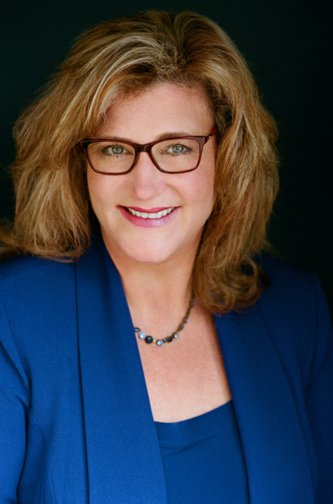
Distant Learning for Elementary COVID-19 ~ Pros and Cons
Melissa D. Patschke, Ed. D.
Elementary Principal
Spring-Ford Area School District
PA Principals Association
COVID-19 Webinar Series
April 16, 2020
Mpats@spring-ford.net
@MelissaPatschke

Slide 2
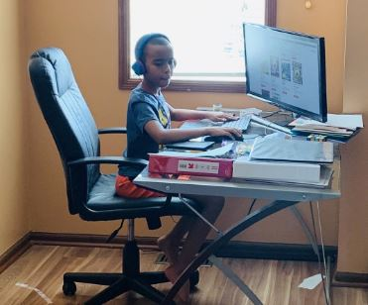
Pros: What’s working?
Kids are safe at home
Flexible scheduling
Increased opportunity for imaginary play
Distractions are minimized
Social concerns are minimal
Creativity and discovery based learning
Opportunity for choice
Encourages independence
New technology is being used and explored
Family engagement in the learning process

Slide 3
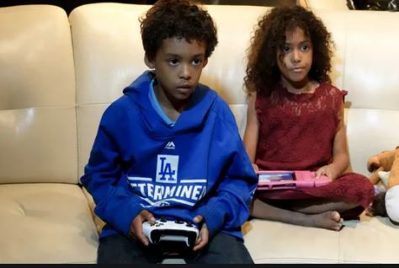
Cons: Where’s the struggle?
Student motivation is lower
Families are compromised financially
Families are struggling to meet everyone’s needs
Children with little supervision or structure are missing out
Social engagement is sorely missed
Technology isn’t always working or available
Screen time has increased significantly
The relational aspects of learning are compromised
Children that require hands on therapies and supports
Children with learning differences or social/emotional concerns

Slide 4
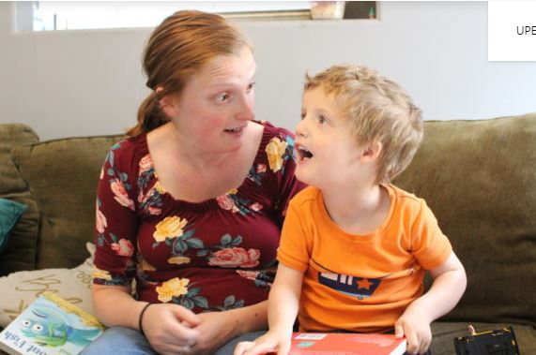
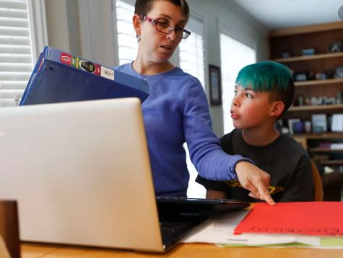
What can we do for our students?
Experience group and individual sharing times
Prioritize relationships with teachers, staff and peers
Compliment parent efforts to teach and support students
Minimize expectations for quantity and focus on quality
Add movement based, low tech, hands-on activities
Provide activities that can be accomplished independently
Encourage routines and schedules
Build in motivators during and beyond the learning
Create opportunities for joy and laughter
Be flexible and understanding

Slide 5
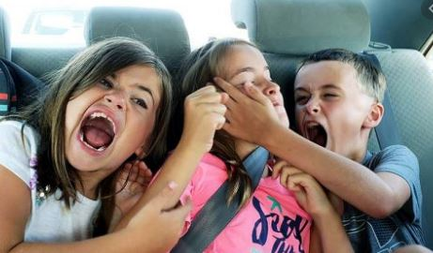
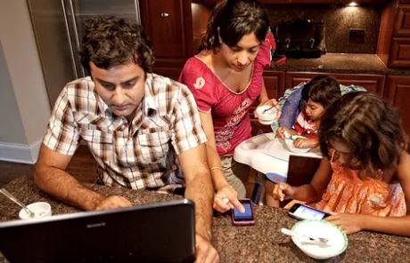
What can we do to support parents?
Be patient, empathetic, and available
Understand that every family is facing new challenges
Offer opportunities to talk, learn from, and connect with staff
Direct them to relevant enrichment opportunities
Allow parents to modify plans to meet the needs of their child
Prioritize them as people, permission to be human
Support their effort with praise and gratitude
Continue to prioritize relationships and build the school culture

Slide 6
What can we do for our teachers?
Be patient, empathetic, and listen
Understand that they are new to this environment
Provide opportunities to share with colleagues
Provide the tools teachers need to be successful
Encourage boundaries around their time
Prioritize them as people, permission to be human
Build a team mindset, we are in this together
Be the visible, visionary leader they need during this crisis

